Slide 1


The City that Never Sleeps (too Much Noise)
Thiago Marcon
Manuel Curral

Slide 2

Dataset
311 Service Requests.
January 2021 – June 2023.

Slide 3
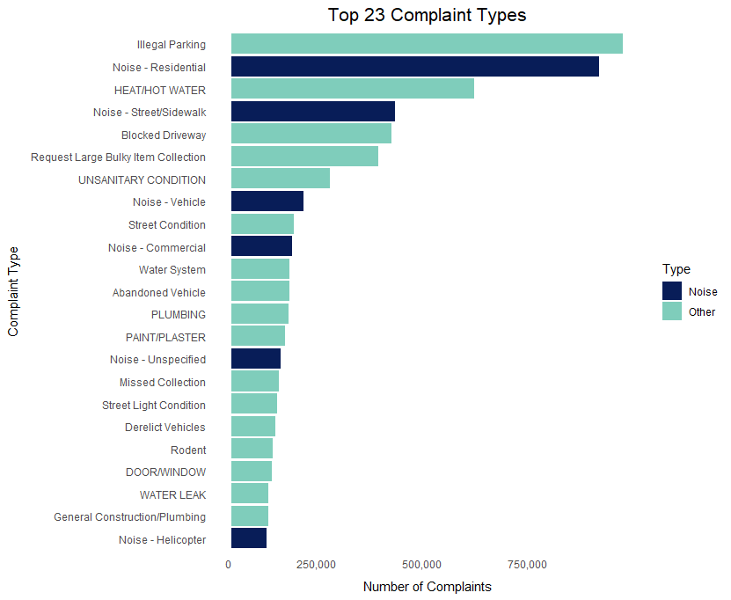
Of the top twenty-three complaints, six are noise related (about 26%).
Top 23 Complaint Types

Slide 4
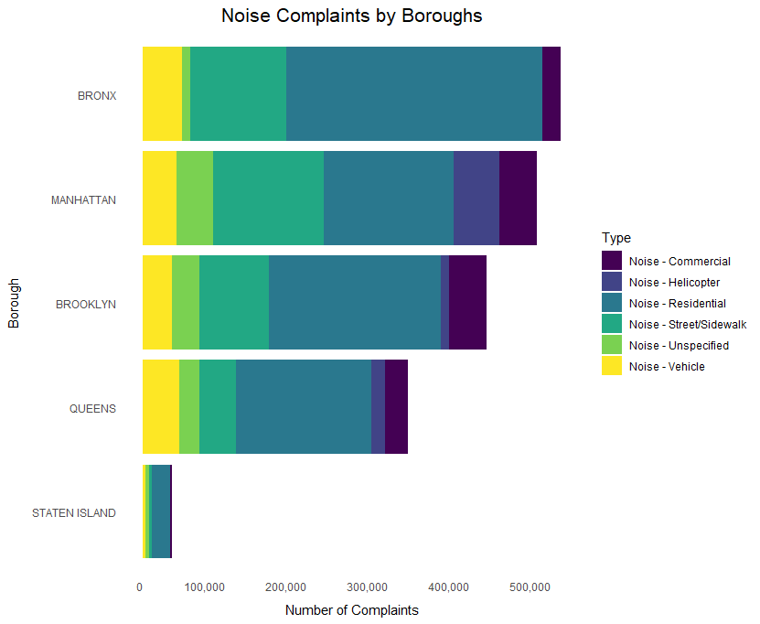
Noise Complaints by Boroughs

Slide 5
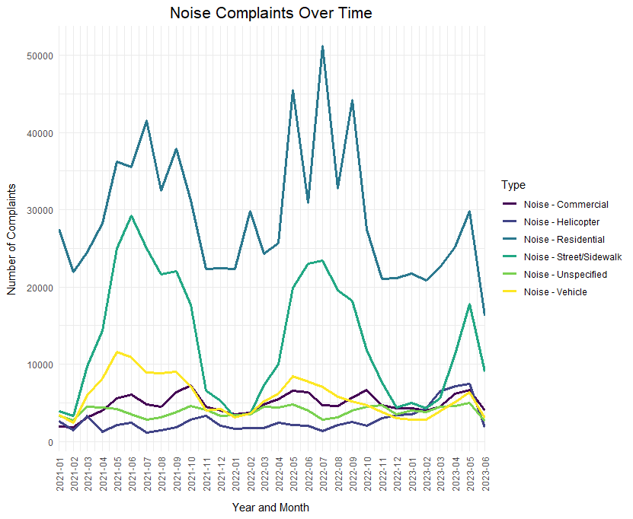
The highest number of complaints occurs between April and September.
Noise Complaints Over Time

Slide 6
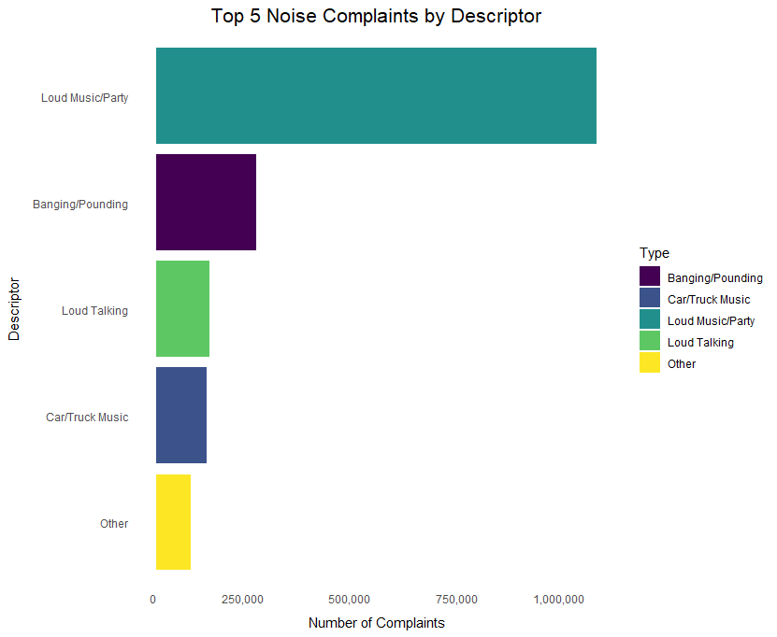
Top 5 Noise Complaints By Descriptor

Slide 7
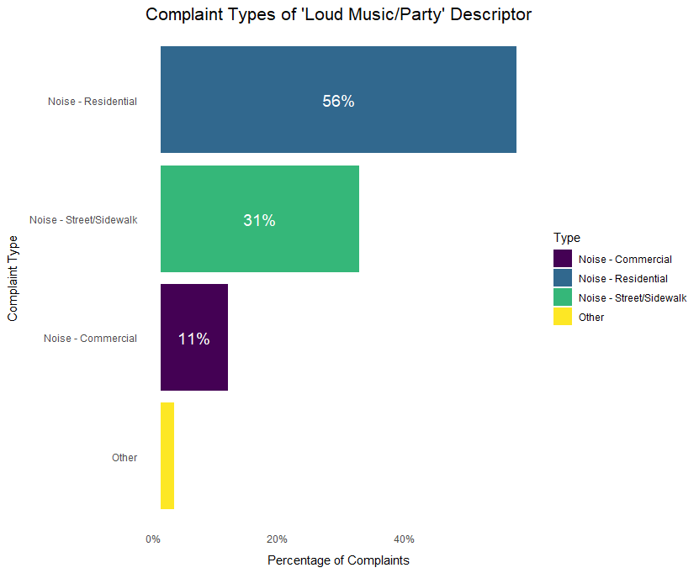
Complaint Types of 'Loud Music/Party' Descriptor

Slide 8
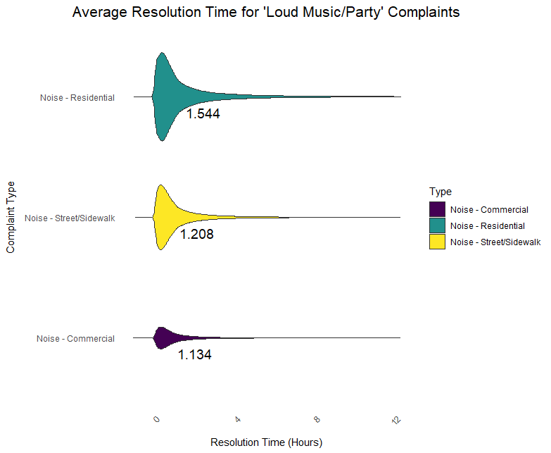
Average Resolution Time for 'Loud Music/Party' Complaints

Slide 9
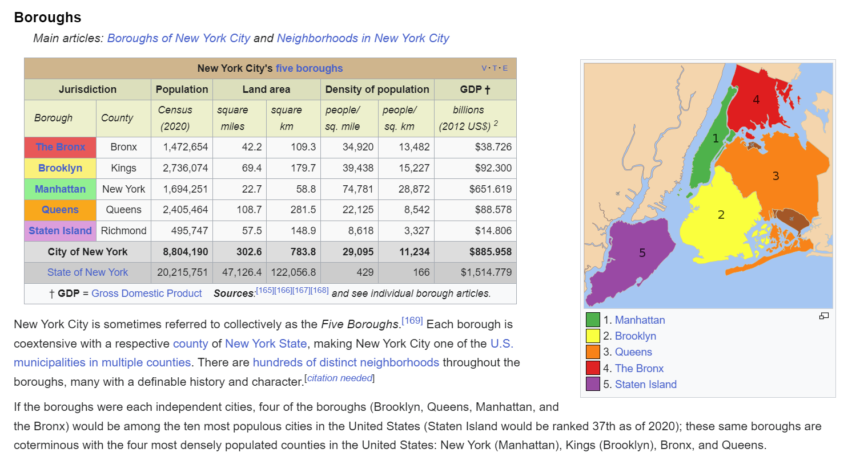

Slide 10
Conclusion

